Slide 1
Cloud Droplet Growth By Condensation
SIO217A
Dara Goldberg, Erica Rosenblum, Jessie Saunders

Slide 2
Talk Outline
-Background & Governing Equations
-Methods
-Results & Discussion

Slide 3
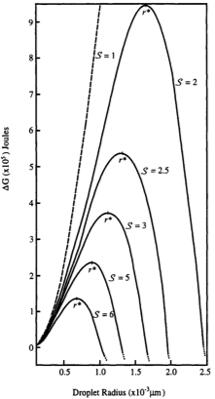
Conditions for Cloud Drop Growth
1) Need to form on a surface
2) When are drops large enough to be stable?
- latent heat balances surface tension
3) Pressure gradient needs to exist between drop and environment
Figure: Curry & Webster 1999
Notes:
-more force on molecules in interior
-takes energy to move them to surface
-energy comes from latent heat
-latent heat ~ mass ~r^3
-balancing surface tension ~ surface area ~ r^2
→ critical radius of drop
-less escaping molecules
→ vapor pressure can be much larger in drop than on flat surface

Slide 4
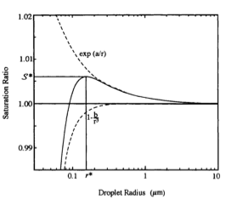
Conditions for Cloud Drop Growth
1) Need to form on a surface
-CCNs make this easy
2) When are drops large enough to be stable?
- effect of surface tension dominates effect of solute
3) Pressure gradient needs to exist between drop and environment
Figure: Curry & Webster 1999
Notes:
-more force on molecules in interior
-takes energy to move them to surface
-energy comes from latent heat
-latent heat ~ mass ~r^3
-balancing surface tension ~ surface area ~ r^2
→ critical radius of drop
-less escaping molecules
→ vapor pressure can be much larger in drop than on flat surface

Slide 5
Diffusion
1) Vapor Pressure of environment > Saturation Pressure of Drop
*need a pressure gradient*
2) Condensation on to drop → Latent heat released
3) Drop heated → Saturation Pressure of drop Decreases
→ Pressure gradient Decreases
→ Growth Decreases
Equation derived by Mason 1971
Notes:
-P_env (vap pres) > P_drop (sat vap pres)
-i.e. need a pressure gradient
-condensation onto the drop → latent heat released
-add heat to drop→ P_drop increases
→ pressure gradient reduced → less droplet growth
*assuming mass is added to the drop by diffusion only:
-equation 1 (Mason 1971) and definitions of K, D and S

Slide 6
Summary and Goal
- For diffusional growth:
-big enough drop
-pressure gradient
Question: How does uplift affect droplet growth through diffusion?

Slide 7
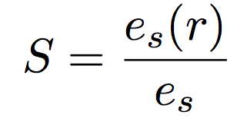
Evolution of Supersaturation
1) Definition:
2) Uplift → Temperature *Decreases*
→ Saturation pressure *Decreases*
→ Supersaturation *Increases*
3) No infinite source of water vapor
-as water vapor condenses less is
available for growth
→ Supersaturation *Decreases*
Notes:
- Definition of S=e_s(r)/e_s
-reminder that because of surface tension, e_s(r)>>e_s
**think both is a function of T, but to first order, e_s(r) is not**
-Equation (2) and explain
-as temperature goes up, e_s goes down, so S goes up!
-water vapor is not infinite, as more is condensed there is less available for more growth, so S goes down!

Slide 8
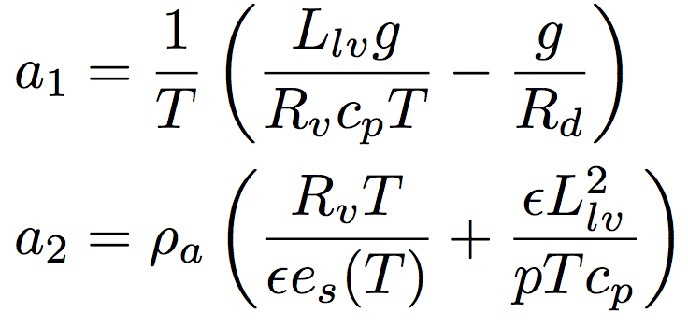
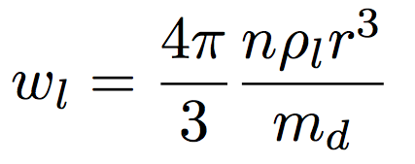
Governing Equations

Slide 9
Model Conditions
- Based initial conditions off of Mordy (1959) who first investigated this effect
- Initial conditions:
- saturated parcel
- distinct population of CCN (10 nm - 50 μm)
- 800 mb level
- constant upward velocity of 0.1 m/s

Slide 10
CCN Distribution
- CCN number density depends on region and size
- maritime conditions: smaller and fewer CCN
- continental conditions: larger and more CCN
- Total amount of CCN per unit volume of air:
- Chose uniform distribution of CCN over initial radii
population

Slide 11
Solving for r and S
r and S cannot be solved analytically

Slide 12
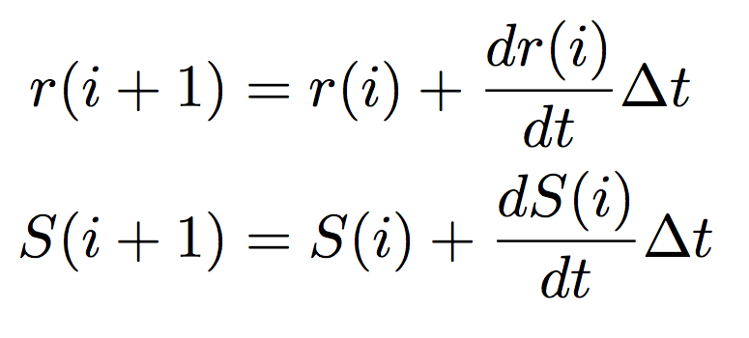
Solving for r and S
Solve for r and S incrementally over time:
Time step chosen: 0.025 s
- r and S calculated every 2.5 mm during ascent

Slide 13
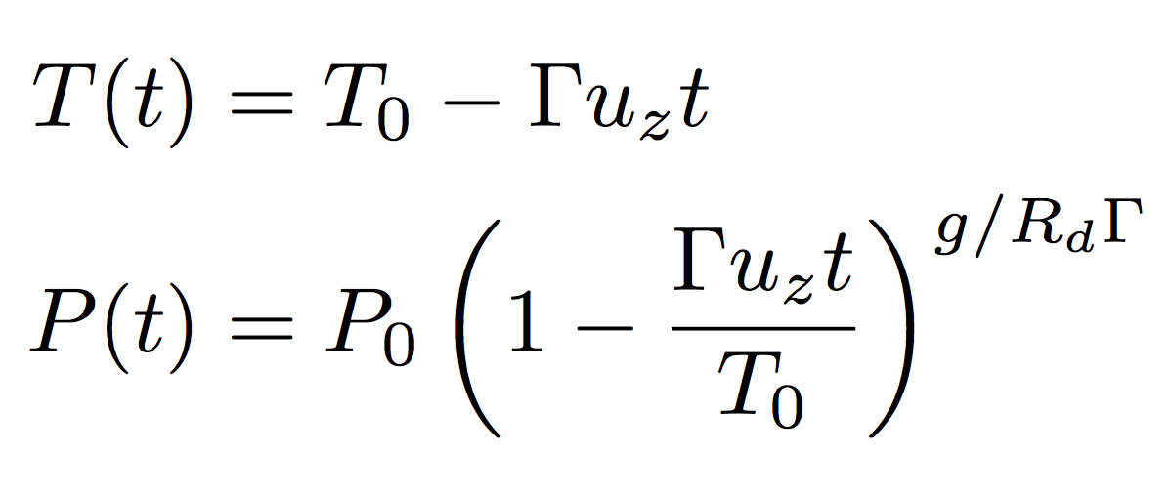
Other time variations
Assuming hydrostatic balance and adiabatic cooling:
Chose constant lapse rate of 4 K/km

Slide 14
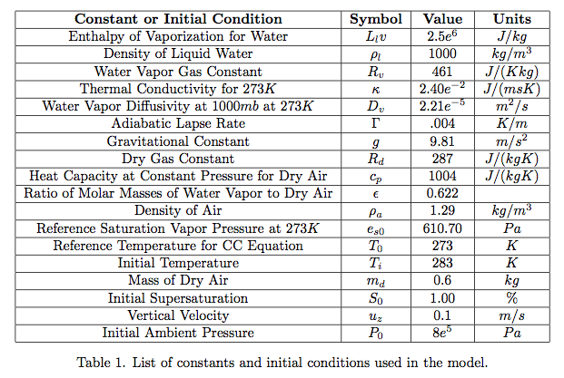
Other constants used in the model

Slide 15
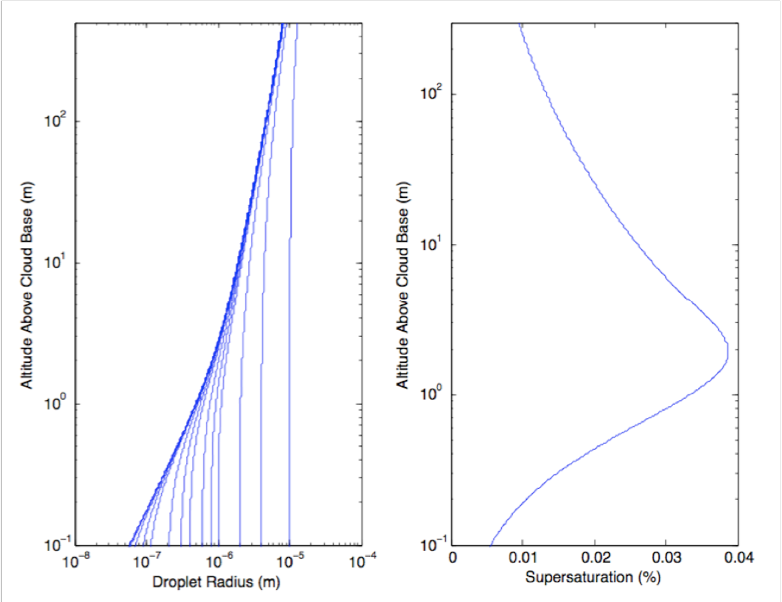
Results and Discussion
Supersaturation curve:
-Increases as expected with increasing altitude/ decreasing temperature
-Reaches a maximum and decreases as more water condenses. (dw_{l}/dt becomes dominant)

Slide 16
Results and Discussion
Droplet Radius:
-Smaller droplets increase in radius faster than larger droplets
-Results are consistent with geometry of spherical droplet.

Slide 17
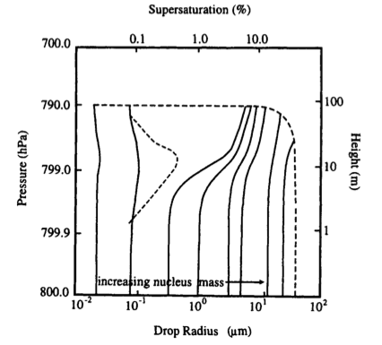
Comparison to Rogers and Yau 1989
Left: Evolution of a cloud drop spectrum from an assumed updraft velocity and initial distribution of CCN. Solid lines show the sizes of drops growing on nuclei of different masses. The dashed line shows how the supersaturation varies with height.

Slide 18
Results and Discussion
Sources of Error:
-All droplet radii activated in our model.
-Assumption of constant adiabatic lapse rate
-Simplification of CCN distribution

Slide 19
Works Cited
Curry, J. A. & Webster, P. J., 1999. Thermodynamics of Atmospheres and Oceans. San Diego: Academic Press
Mason, B.J., 1971: The Physics of Clouds. Clarendon Press, Oxford, 671 pp.
Mordy, W., 1959: Computations of the Growth by Condensation of a Population of Cloud Droplets. Tellus XI, 1, pp.16-44.

